Slide 1
Secure Finance Spreadsheet
David Pereira

Slide 2
What it is:
Police finance spreadsheet that will be easier to understand and it will do the calculations all for you
Data will be saved to and loaded from external files
There is a secure login which uses a different form, so that data can only be loaded when this login form is completed
Will have a find function that will search and sort data to show an overview e.g. show pay for each unit

Slide 3
…
Login will have a limited number of attempt they can have before the program shuts down
When the program is running, if nothing has been done for 10 minutes then the program will automatically save and turn off
Data will be able to be changed and saved
When closing the program the user will have the option to save their data

Slide 4
How it is different from current systems:
The current system they use means that they have to enter calculations themselves
It is very hard to read and sort
They have to log out themselves out when they leave, 10 minutes gives them time to be able to take a quick call or go to the toilet etc.
Only have username and password to be entered to be able to access all police finances.

Slide 5
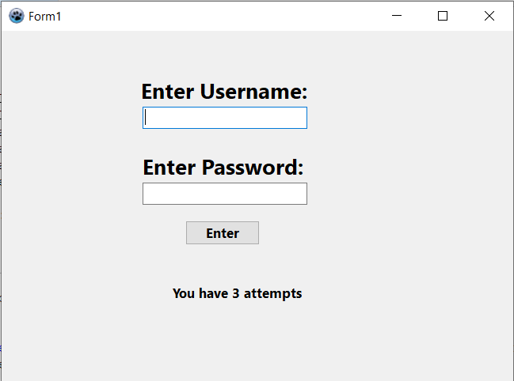
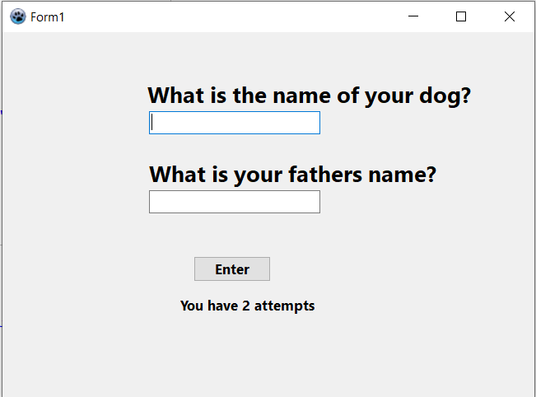
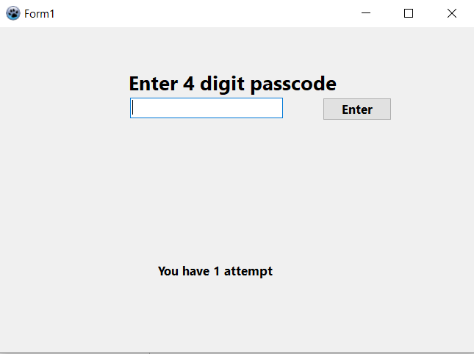
Login

Slide 6
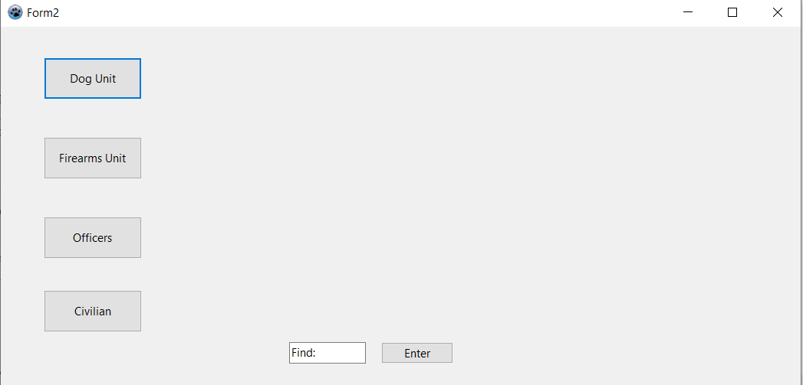
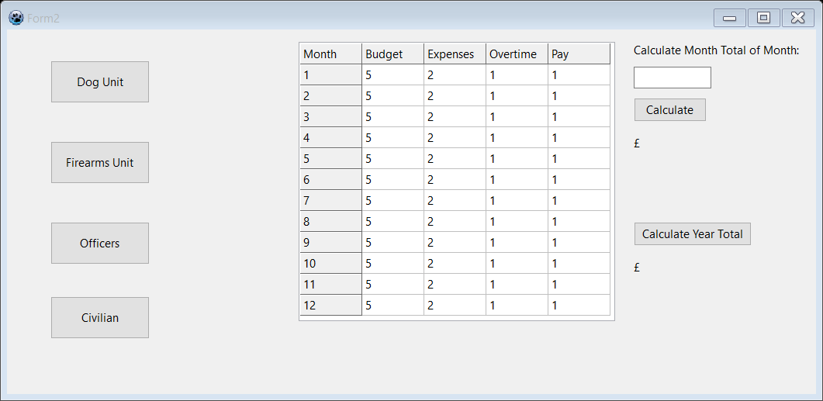
Sheet

